Slide 1



G H PATEL COLLEGE OF ENGINEERING & TECHNOLOGY
( A Constituent College of CVM University )
DEPARTMENT OF COMPUTER ENGINEERING
A PRESENTATION ON SUMMER INTERNSHIP AT :
Online Bookstore Website
Guided by:
Dr. Priyang Bhatt
Prof. Hetal Gaudani
Prof. Nirav Raja
Prepared by:
Darshan Jhagadiawala (11)
Herin Patel (18)
Jainik Patel (21)
Karmadipsinh Solanki (25)

Slide 2



Presentation Content :-
About the company
Services offered by the company
Purpose and Scope for internship
Internship project assigned
Technologies utilized
Key features to included
2

Slide 3
Presentation Content :-
7) Website development process
8) Webpages created
9) Project Design
10) Project outcome
11) Challenges faced
12) Conclusion
3

Slide 4

4

Slide 5
Company Name | TatvaSoft: Software Development Company
Address | TatvaSoft House, Near Shivalik Business Center Sarkhej - Gandhinagar Highway, Rajpath Rangoli Rd, Ahmedabad, Gujarat 380054
Contact Number | 096014 21472
Year of Establishment | 2001
Email | info@tatvasoft.com
Company Website | https://www.tatvasoft.com/

Slide 6
A Consummate Custom Software Development Company delivering splendid business IT Solutions and related services to customers across the globe.
The development services are led by dedicated and passionate team to provide best and industry practices combined with technology expertise and business domain knowledge.
The proficiency in understanding business challenges and professional competence allows them to create a better experience for the customers.

Slide 7
They have successfully served for more than 1800 success stories ranging from Enterprise level to Start-ups, who have grown alongside the success of the company.
At present they are a Robust Team having diverse skills with more than 21+ years of Technology experience engaging with customers at Deeper level to provide cutting edge solutions and innovations.
They continue to provide internships to students and jobs to affiliate students and staff who want to enhance their knowledge in the technical market.

Slide 8
2. Services offered by TatvaSoft :-
1) Custom software development
2) Web Application development
3) Software testing and QA
4) UI/UX Design
5) E-commerce development
6) Mobile app development
8

Slide 9
3. Purpose & Scope of Internship :-
Purpose :
Create an engaging and practical learning experience in web development.
Apply modern web technologies in a real-world scenario.
Scope :
Develop a Bookstore App from scratch using ReactJS, Material UI, and APIs.
Implement core functionalities for browsing, searching, and purchasing books.
9

Slide 10
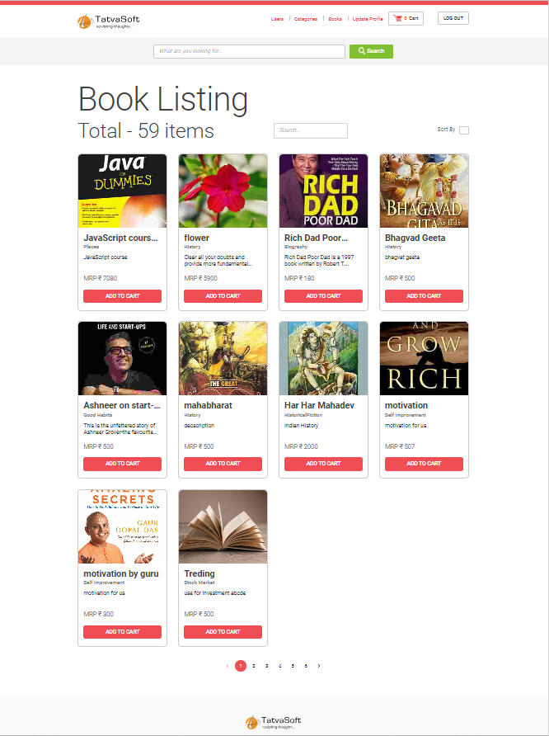
4.
Internship Project Assigned :
Online Bookstore Website using ReactJS

Slide 11
5. Technologies Utilized
ReactJs
Material UI
APIs

Slide 12
6. Key Features to be included :-
User registration and authentication.
Form validation with Formik.
User-friendly UI/UX with Material UI components.
Dynamic rendering of books and categories.
Integration of APIs for retrieving book data.
12

Slide 13
6. Key Features to be included :-
6. Add/Update/Delete Books and users as well.
7. Category list page Add/Update/Delete a category.
8. Pagination, local search and sorting.
9. Cart management and checkout process.
13

Slide 14
7. Website Development Process

Slide 15
7. Website development process
Day | Task Assigned
Day 1 | Download node js What is NPM? Running react project
Day 2 | What is component and for What we should Create component? Create react component Basics of react router dom
Day 3 | What is material design Intro to material UI Implementing Basic components of material UI
Day 4 | Implementing advance material UI components (Includes basics of useState)
Day 5 | UseEffect Formik Registration Page Ui Form Validation with formik

Slide 16
7. Website development process
Day | Task Assigned
Day 6 | Axios API call and toast Registartion Page API Integraion
Day 7 | Login Page UI Login API Integration
Day 8 | Header and footer Global book search
Day 9 | UseContext hook Private route and user redirection AuthContext using useContext
Day 10 | Book Listing Page Pagination, local search and sorting

Slide 17
7. Website development process
Day | Task Assigned
Day 11 | Book list page(For admin and sellers) Add/Update/delete Books
Day 12 | User list page Add/Update/delete users
Day 13 | User profile Category list page Add/Update/delete a category
Day 14 | Cart Page Cart context Add/Update/delete Cart PlaceOrder
Day 15 | AWS Session Deployment

Slide 18

8.
Webpages
Created

Slide 19
8. Webpages created
Registration page
Login page
Book listing page
Edit book page
Edit category page
Update profile page
User list page
Cart page
19

Slide 20
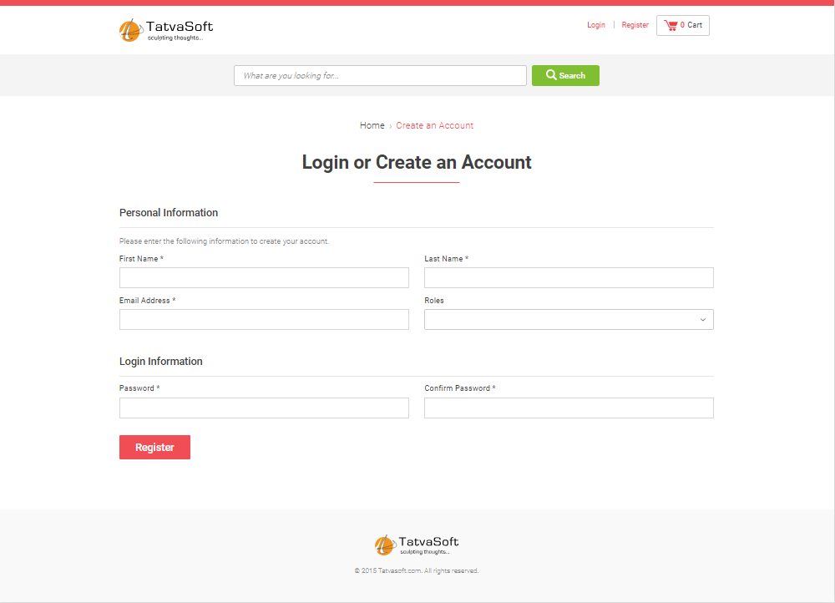
1.) Registration page

Slide 21
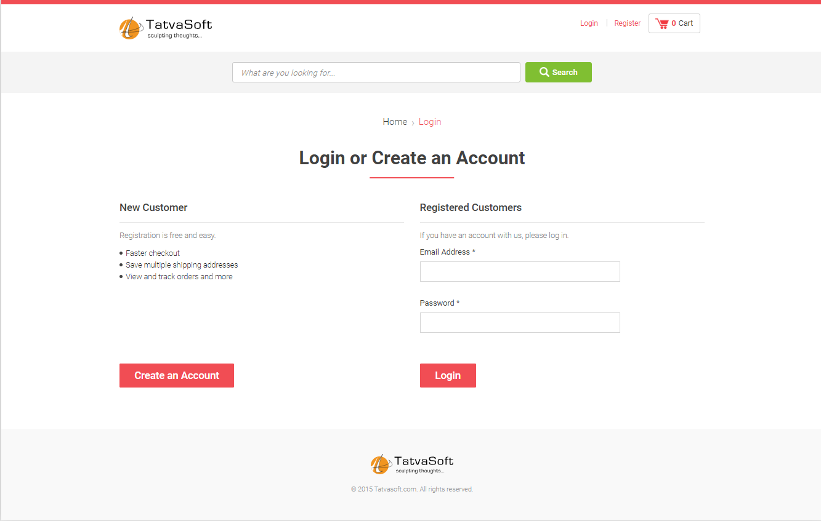
2.) Login page

Slide 22
3.) Book listing page

Slide 23
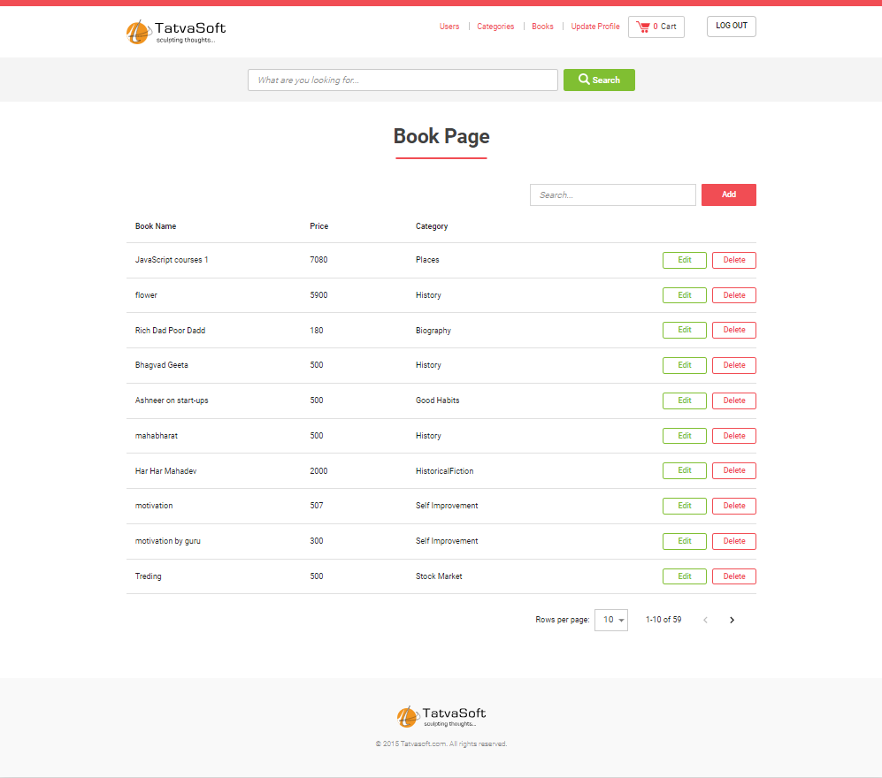
4.) Edit book page

Slide 24
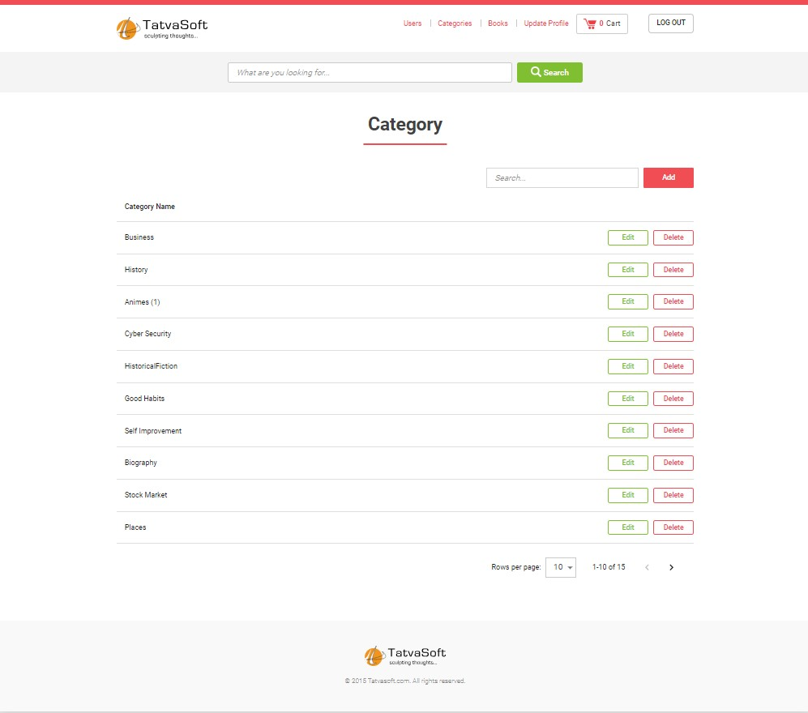
5.) Edit category page

Slide 25
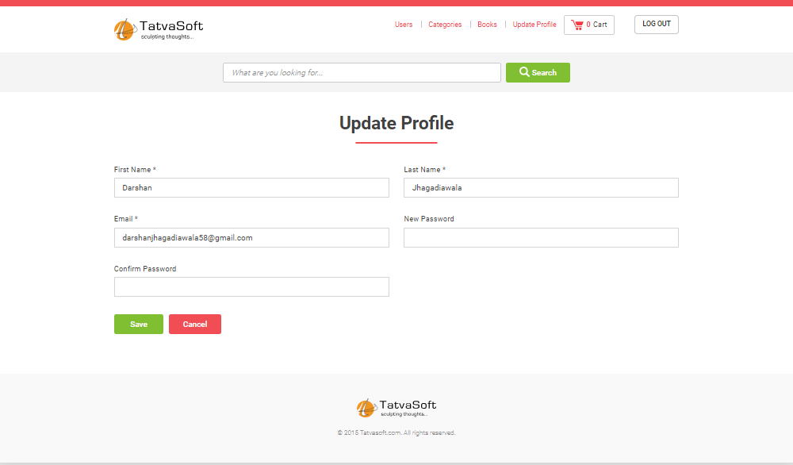
6.) Update profile page

Slide 26
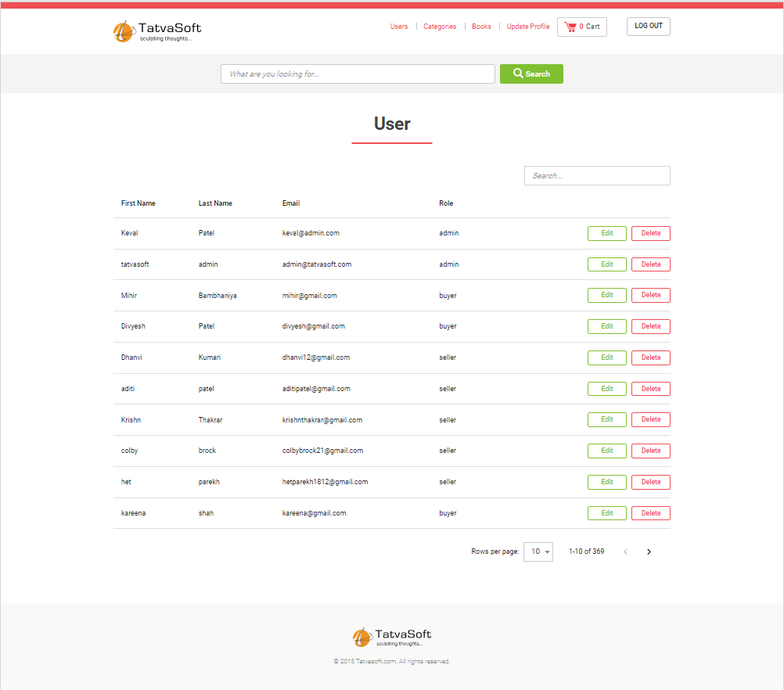
7.) User list page

Slide 27
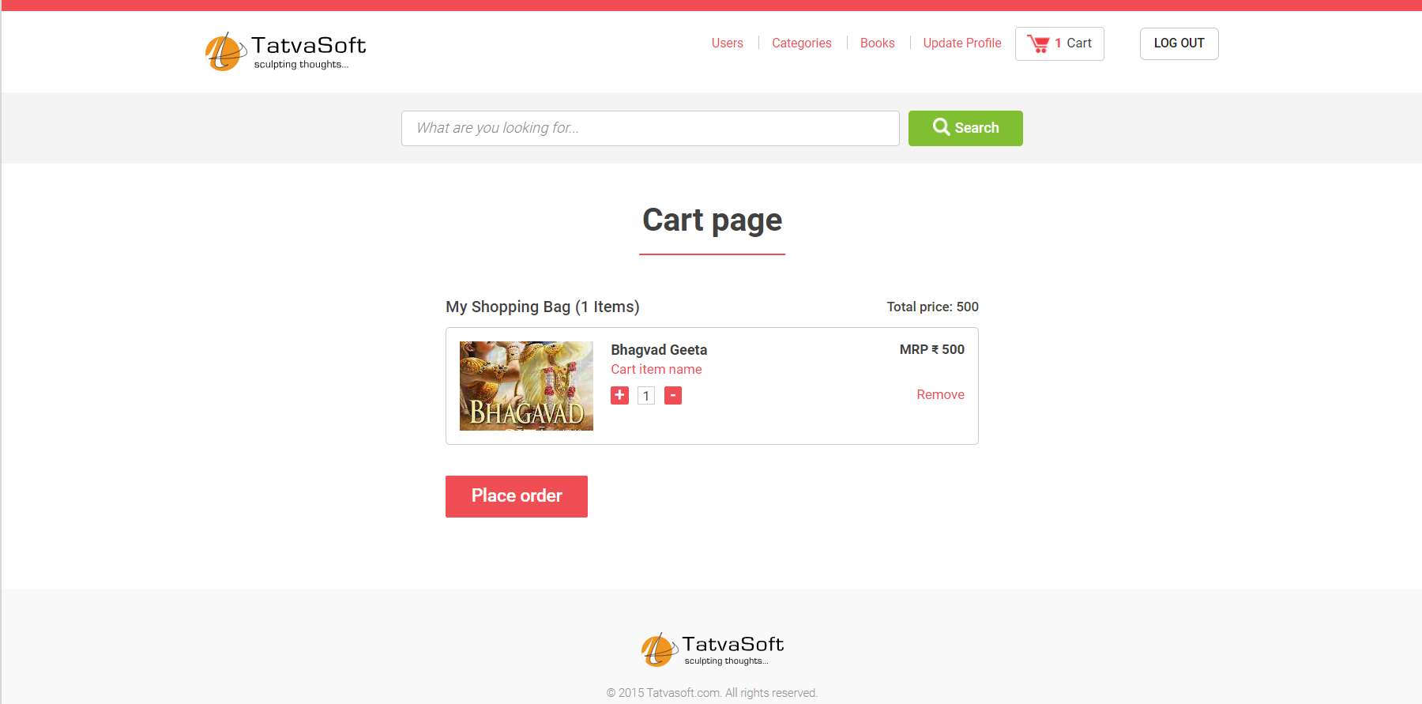
8.) Cart page

Slide 28
9. Project Design
A good project plan and design makes any project a lot easier. Project design is an initial stage of the project.
Here, I am going to present about :-
Use-case Diagram
E-R Diagram
28

Slide 29
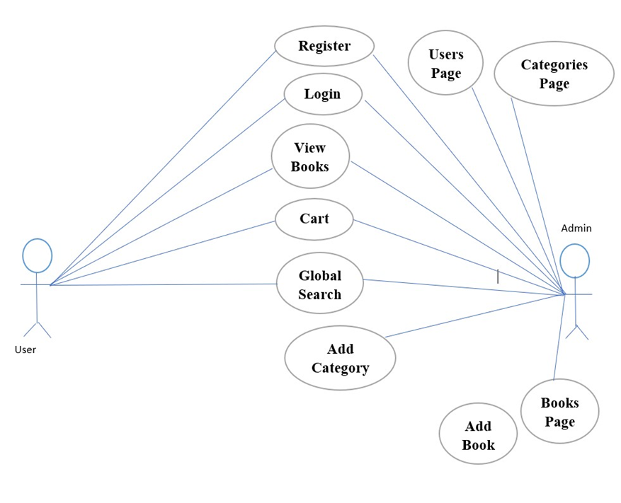
1.) Use-case Diagram

Slide 30
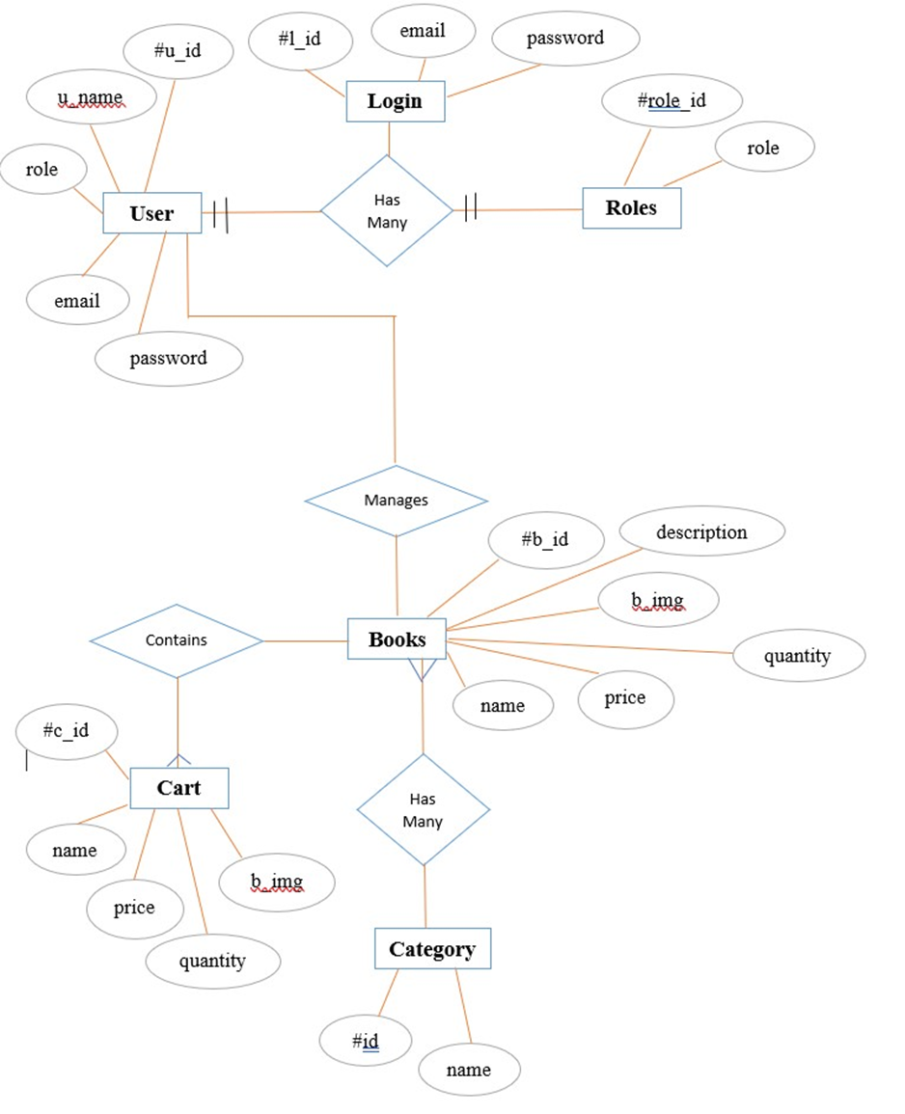
2.) E-R Diagram

Slide 31
10.
Project
Outcome

Slide 32
10. Project Outcome
A comprehensive book store app :
User-friendly interface for browsing and selecting books.
Efficient search and filtering mechanisms for improved usability.
Smooth cart management and checkout process.
Enhanced Web Development Skills:
Proficiency in ReactJS, Material UI, and API integration.
Practical knowledge of developing interactive web applications

Slide 33
Challenges were faced while installing the correct node modules for the webpage as well as implementing it through the correct code using VS-Code editor and its snippets.
Some challenges were faced in form validation using formik because of the continuous updates of versions of the node components.
Implementation of Material UI core components into webpage using the correct designs were also a challenging task.
11.
Challenges Faced

Slide 34
12. Conclusion
ReactJS Skill Enhancement:
Mastered React Hooks for efficient state management.
Styled UI using Material UI components
Effective Time Management:
Successfully met project milestones, honing deadline management skills.
Effective Team Management:
Worked in a group of 4 members to complete the project, having to communicate with all of them efficiently and improving social skills
Future Prospects:
Equipped for industry-relevant web development roles.
Inspired to continue learning and embracing complex projects.

Slide 35
References :-
React.js Official Documentation: The official React.js documentation is an excellent starting point to understand the core concepts, API references, and best practices. It provides a comprehensive guide, tutorials, and examples.Website: https://reactjs.org/
React Tutorial by React.js Team: This official tutorial by the React.js team is a hands-on guide to building a React application from scratch. It covers the fundamentals of React.js and introduces key concepts step by step.Tutorial: https://reactjs.org/tutorial/tutorial.html
Formik: https://www.youtube.com/watch?v=a94FOvaBomQ&list=PLC3y8rFHvwiPmFbtzE WjESkqBVDbdgGu
Material-UI Official Documentation: The official Material-UI documentation is a comprehensive resource that covers all aspects of using Material-UI. It provides detailed guides, API references, examples, and customization options.Website: https://mui.com/
Material-UI GitHub Repository: The Material-UI GitHub repository is an open-source project that hosts the source code, examples, and issue tracking related to Material-UI. It's a valuable resource for exploring the library's implementation and finding community contributions. Repository: https://github.com/mui/material-ui

Slide 36


